Slide 1
Project Envisioning
Team 3

Slide 2
User Understanding Stakeholders
Stakeholder | Role
Marketing Agency | Primary
Agency Client | Primary
Advert Network | Secondary
Advert Viewer | Tertiary
Software Developer | Facilitating

Slide 3









User Understanding Personas

Slide 4
As a <user>, I want <goal>, so that <benefit>.

Slide 5
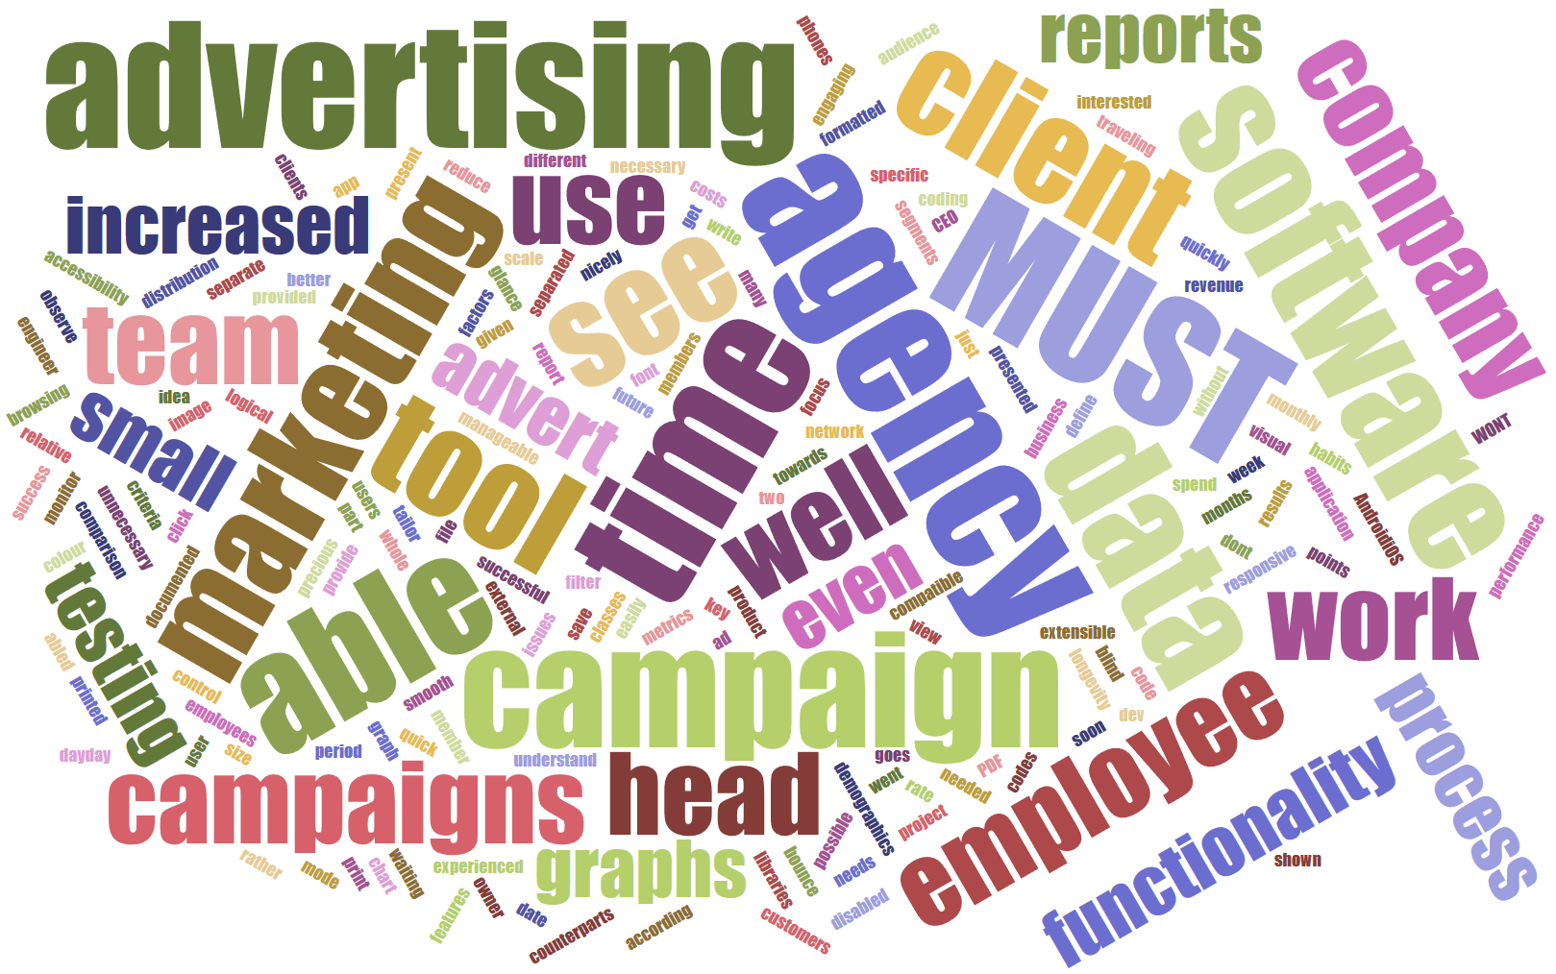
Requirements Planning Project Backlog

Slide 6
Project Planning Increment Plan
Increment 1 | Increment 2 | Increment 3

Slide 7
Project Planning Sprint Plan
Task | Priority | Size
 | Blocking
 | Major
 | Minor

Slide 8
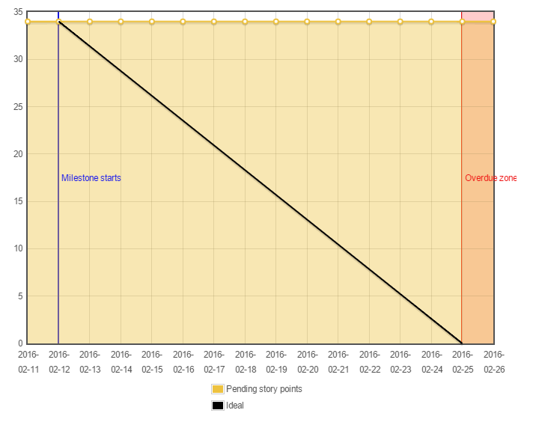
Project Planning Burndown Chart

Slide 9
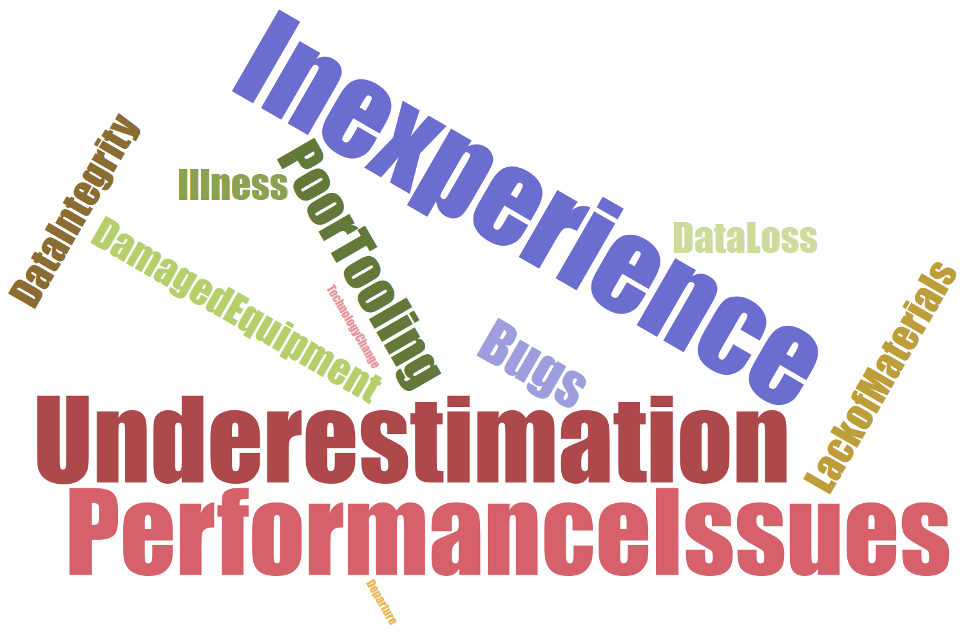
Project Setup Risk Analysis

Slide 10







Project Setup Tools

Slide 11
Thanks for Listening
Any Questions?

